Slide 1
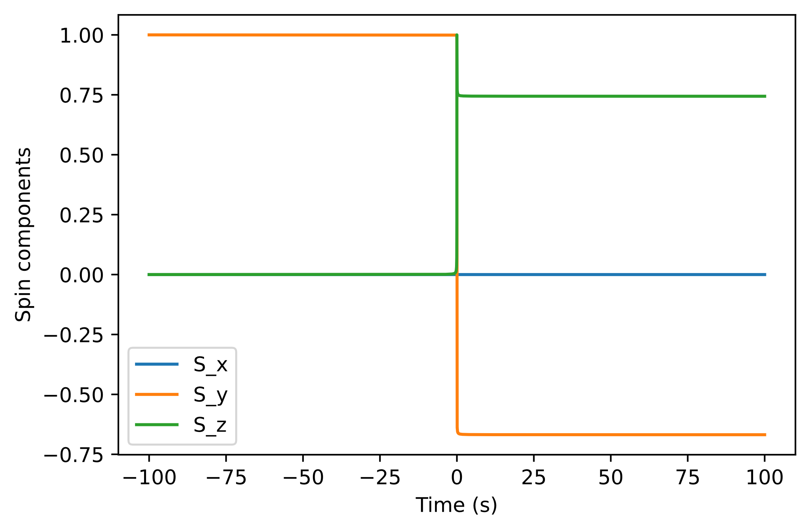
Final spin: [0.0, -0.6682047135397682, 0.7439771503034246]
Speed: 1000 m/s
Wire separation: 10 m
Top wire: 10 A
Bottom wire: -10 A

Slide 2
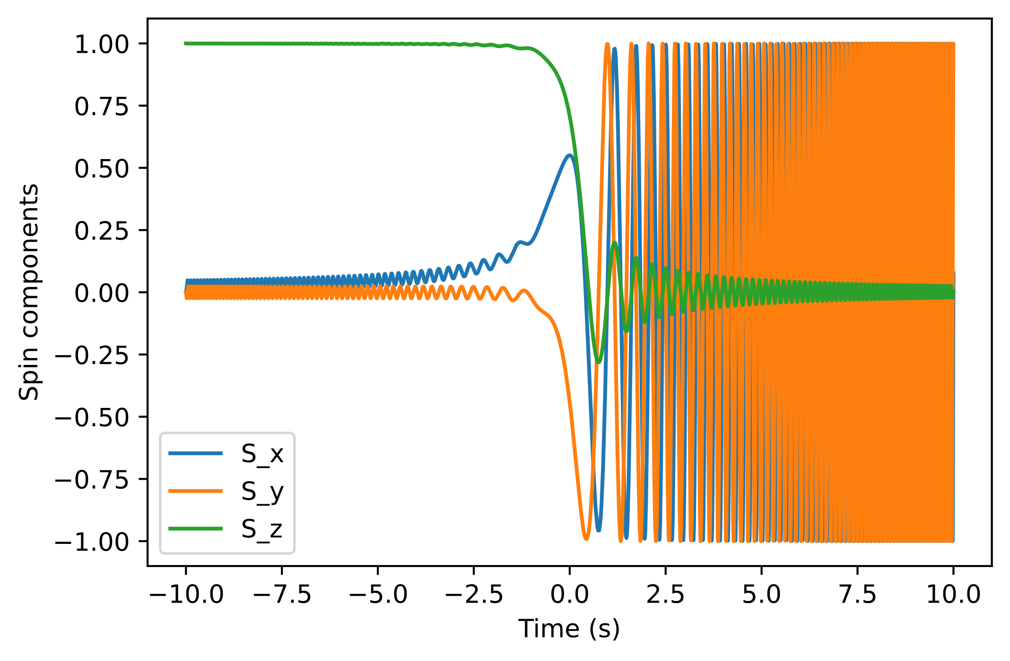
Hx = 10, H_dot = -41.5
Final spin: [0.07625445246664814, 0.9970861336744352, 0.003762795417459164]
Corresponding realignment probability: 50.18813977087295%
Theoretical realignment probability: 49.97872272254392%

Slide 3
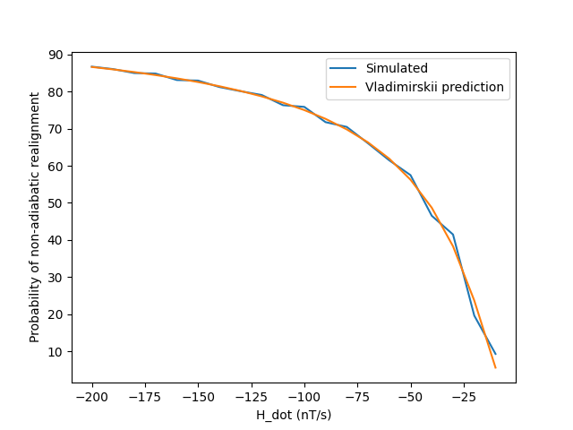
Hx = 10 nT
Simulated for: 20 seconds

Slide 4
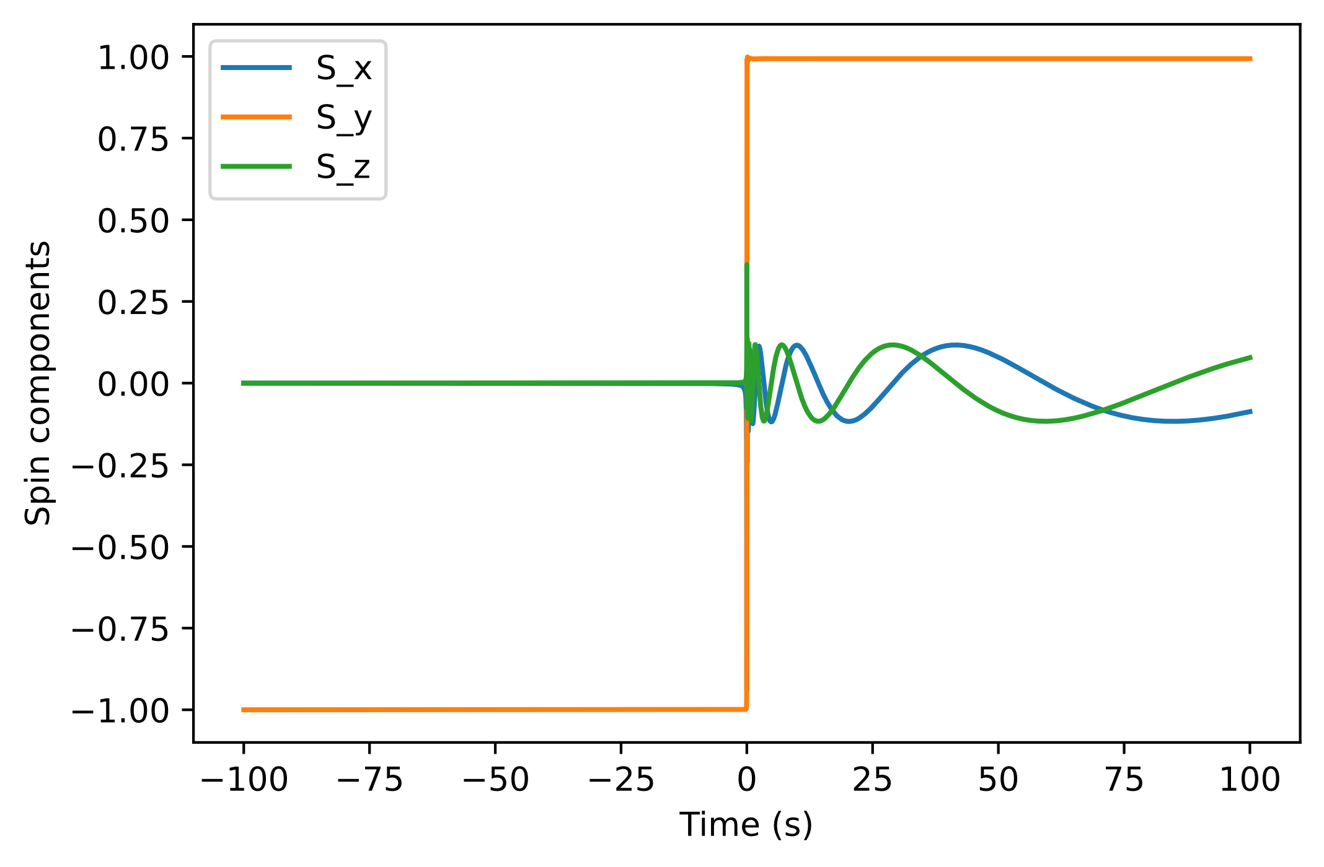
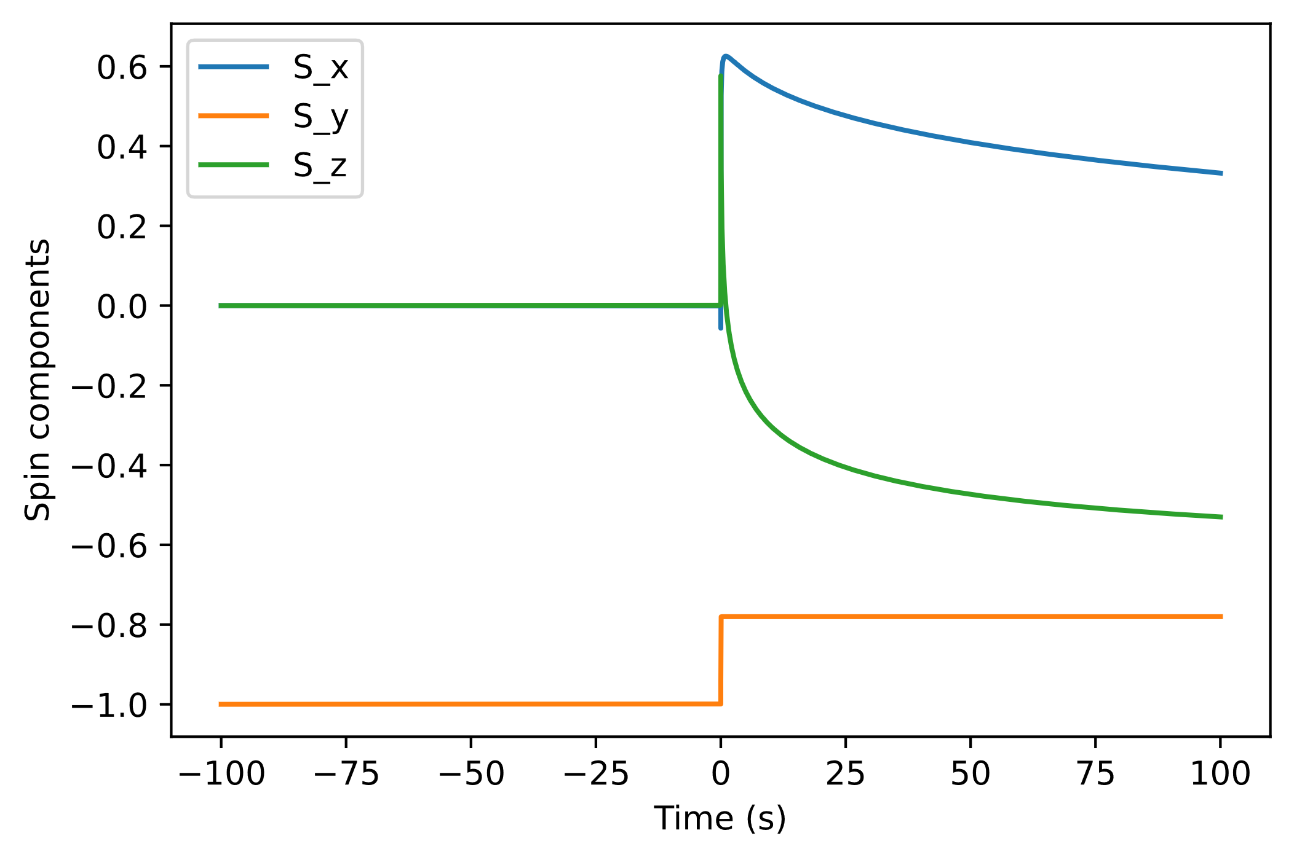
Position: traveling along y = 4.5 cm
Wire separation: 5 cm (one at y = 2.5 cm, the other at y = -2.5 cm)
Top wire: 0.3 A
Bottom wire: 0.3 A
Speed = 5 m/s
Final spin: [-0.08735400424031332, 0.9931222835729916, 0.07795298299791759]
Speed = 100 m/s
Final spin: [0.33223344714498293, -0.7801738237958111, -0.5300469683788319]

Slide 5
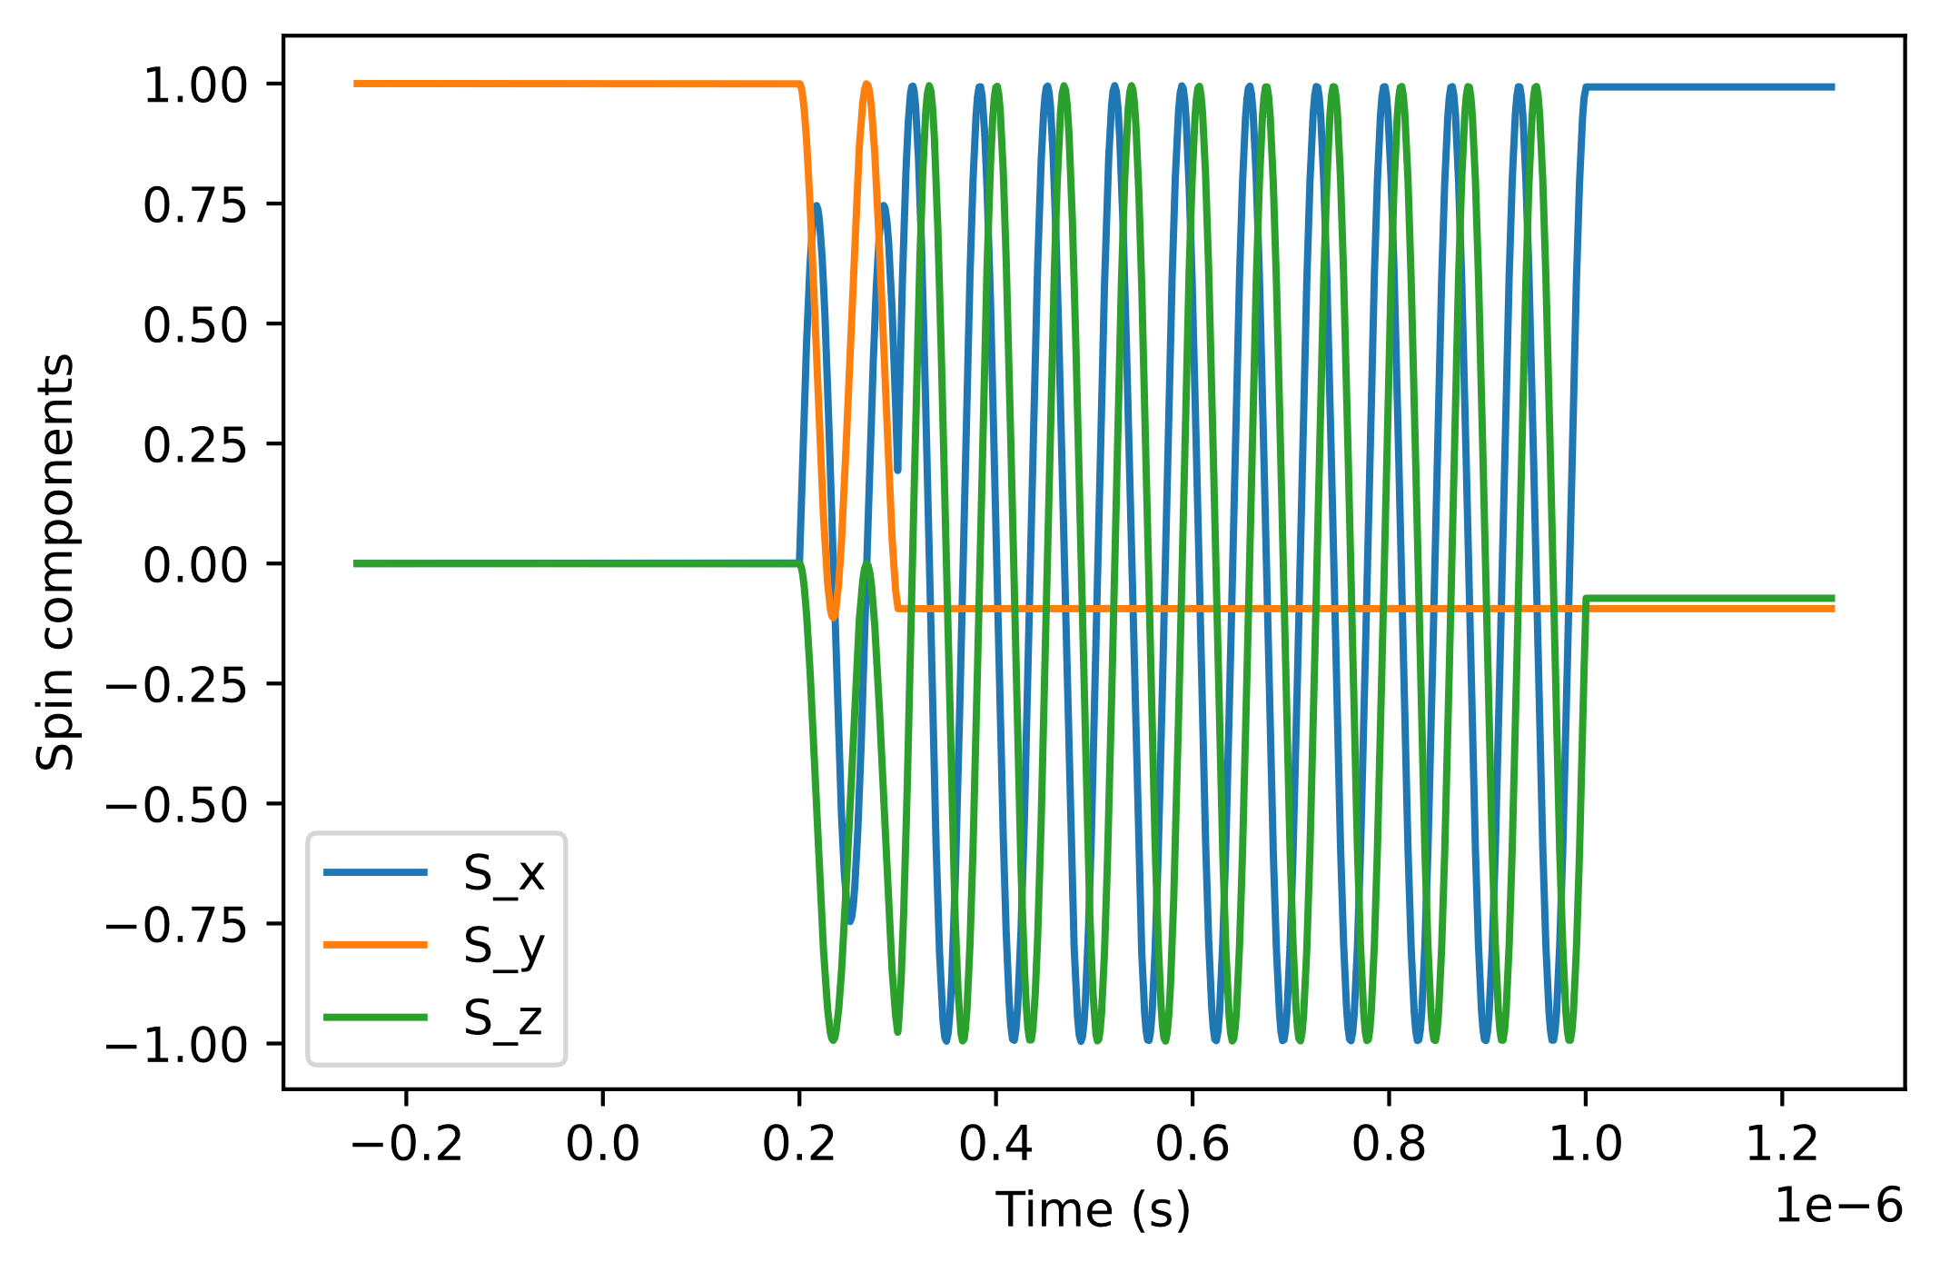
Final spin: [0.9929377240255438, -0.09402723622844013, -0.072357613056144]
Metglas domain field strength: 0.5 T
Domain dimensions: 10 μm x 10 μm
Speed: 100 m/s
Saturation: 0.82
Metglas length: 0.1 mm
Metglas width: 0.1 m

Slide 6
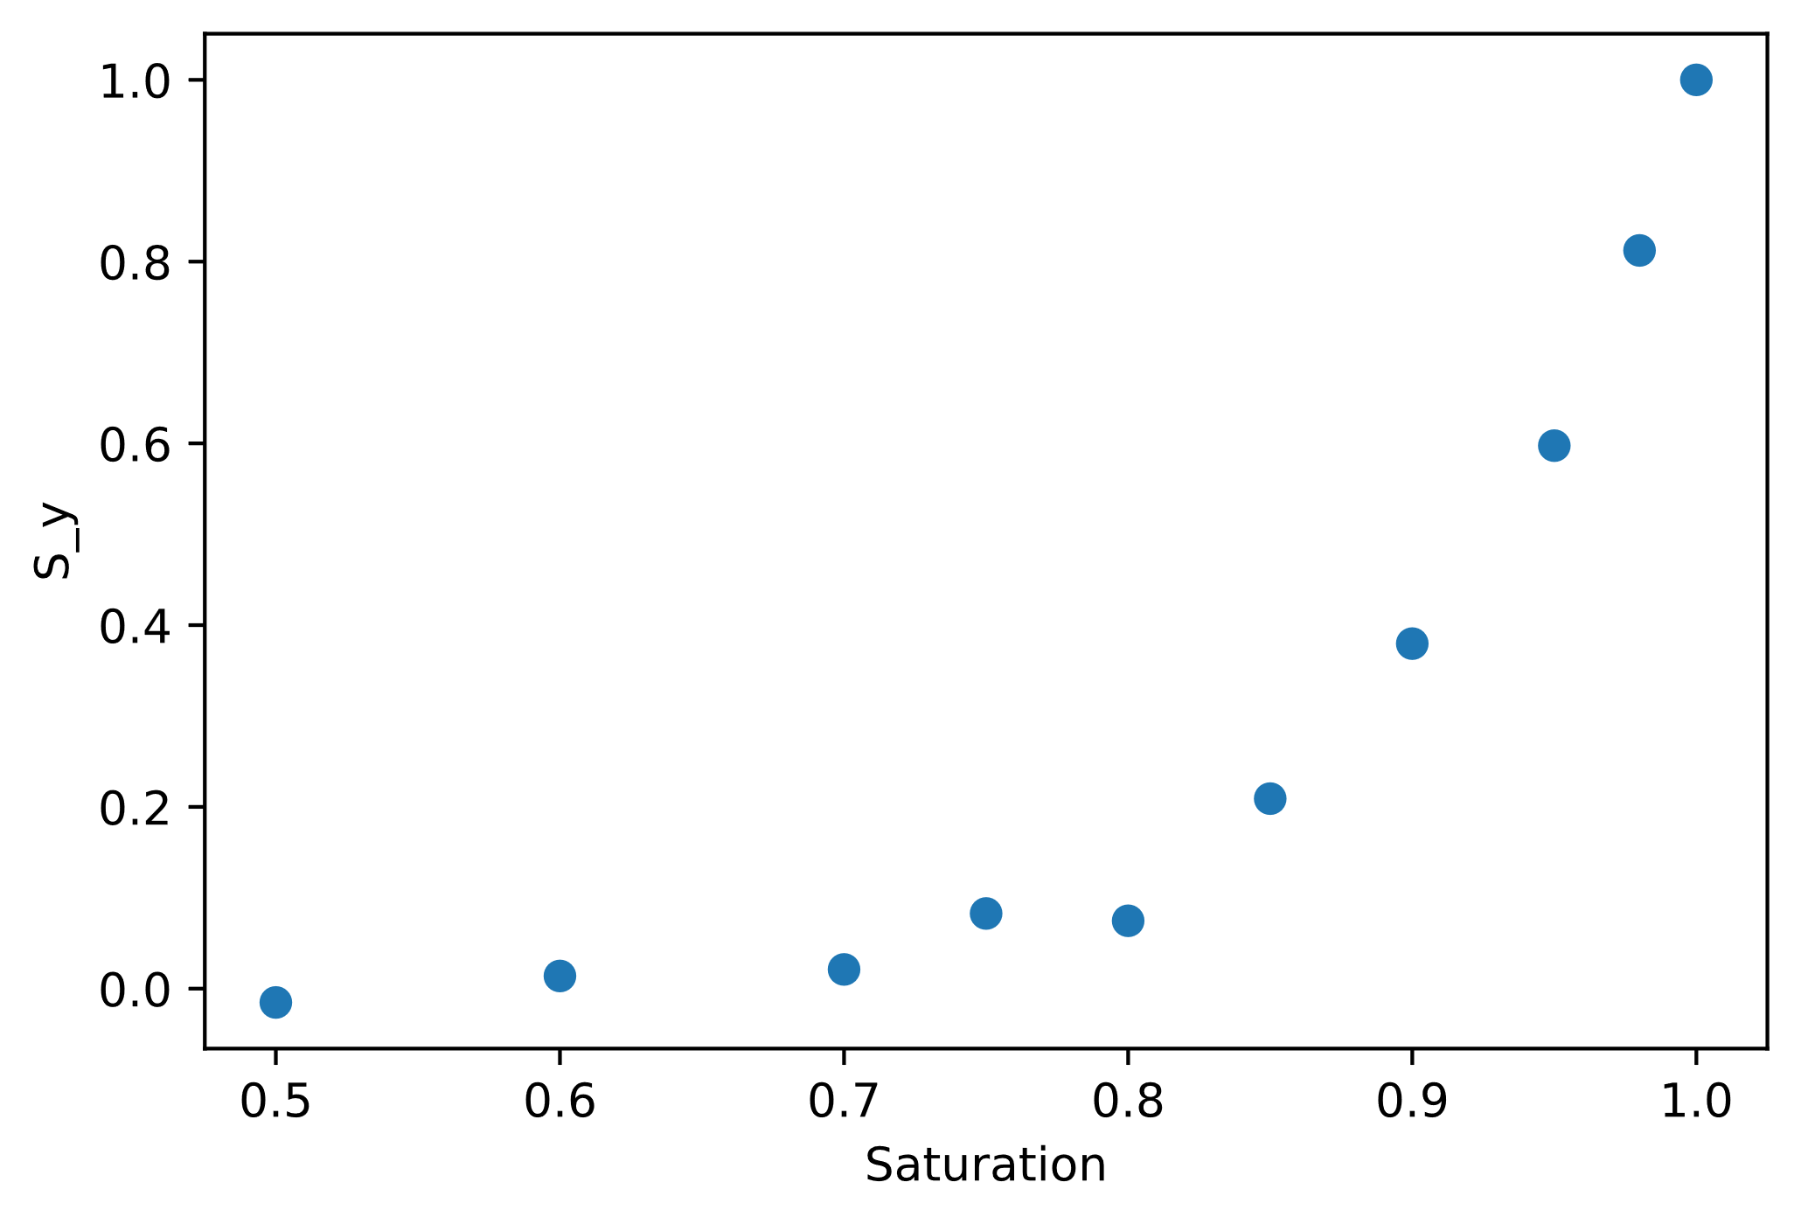

Slide 7
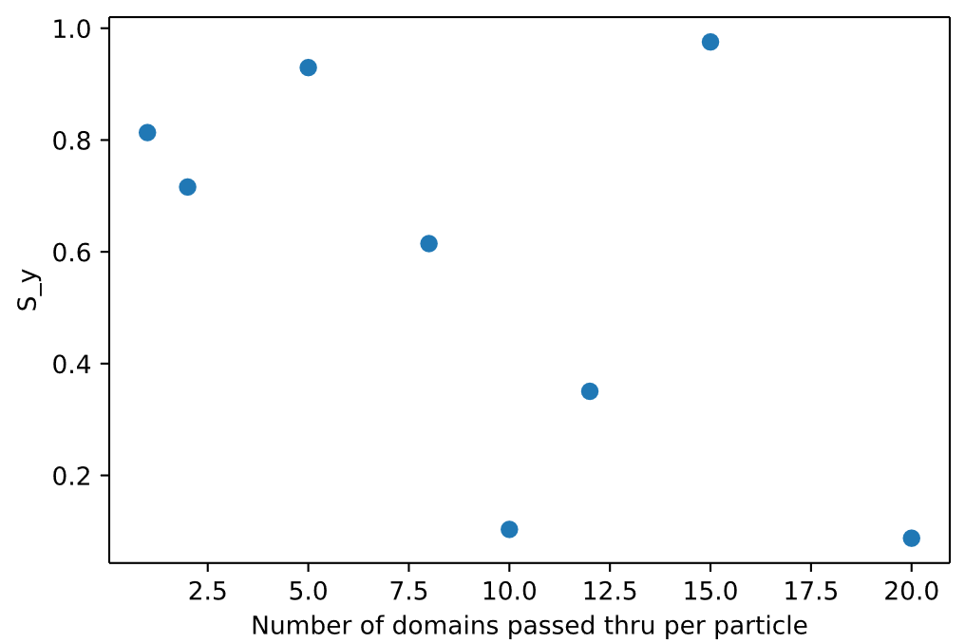
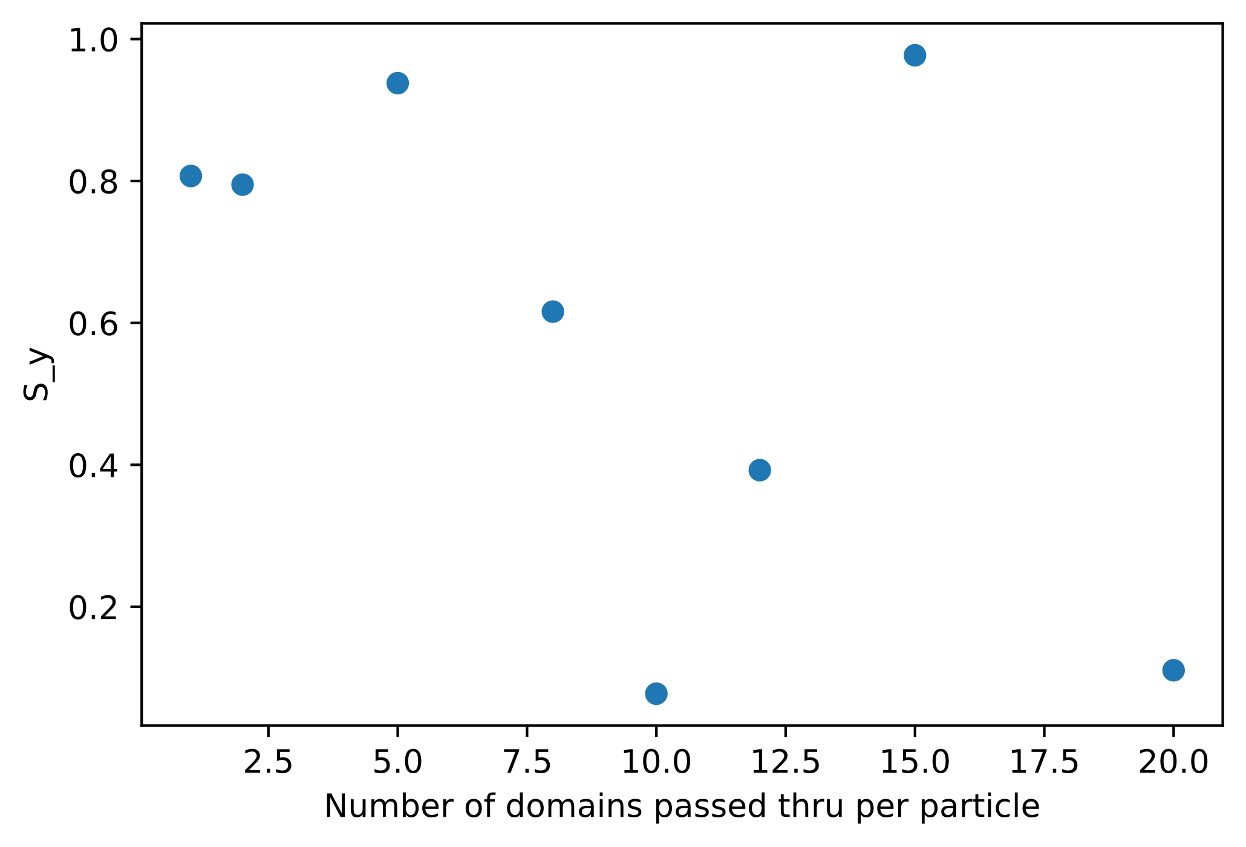
Number of domains passed thru per particle = [1, 2, 5, 8, 10, 12, 15, 20]

